Slide 1
Chapter 11
Some Lessons from Recent Capital Market History
Hillier, Fundamentals of Corporate Finance 4e

Slide 2
Chapter Overview
Returns
The Historical Record
Average Returns: The First Lesson
The Variability of Returns: The Second Lesson
More about Average Returns
Capital Market Efficiency

Slide 3
Returns

Slide 4
Cash Returns
Percentage Returns

Slide 5
Returns
Dividend Income
Capital Gains
Total Monetary Return

Slide 6
Monetary Return
Returns
You purchase 100 shares at £37 each
Total Investment = £3,700
Scenario 1:
Dividend: £1.85 per share
Share price = £40.33
Total Cash Return =
(£1.85 + £40.33 – £37) x 100 = £518
Scenario 2:
Dividend = £1.85 per share
Share price = £34.78
Total Cash Return = (£1.85 + £34.78 – £37) x 100
= -£37

Slide 7
Returns

Slide 8
Returns
Dividend Yield
Capital Gains Yield
Percentage Return

Slide 9
Returns
Dividend Yield
Div_{t-1}/P_{t}
Capital Gains Yield
(P_{t} – P_{t-1})/P_{t-1}
Percentage Return
Dividend Yield + Capital Gains Yield

Slide 10
Returns
P₀ = £37 Div₁ = £1.85 P₁ = £40.33
Dividend yield = Div_{t+1} / P_{t}
= £1.85 / £37
= 0.05
= 5%
Capital gain = (P_{t+1} – P_{t}) / P_{t}
= £40.33 – £37 / £37
= £3.33 / £37
= 0.09
= 9%
R_{t+1} = [Div_{t+1} / P_{t}] + [(P_{t+1} – P_{t}) / P_{t} ]
= 5% + 9%
= 14%

Slide 12
The Historical Record

Slide 13
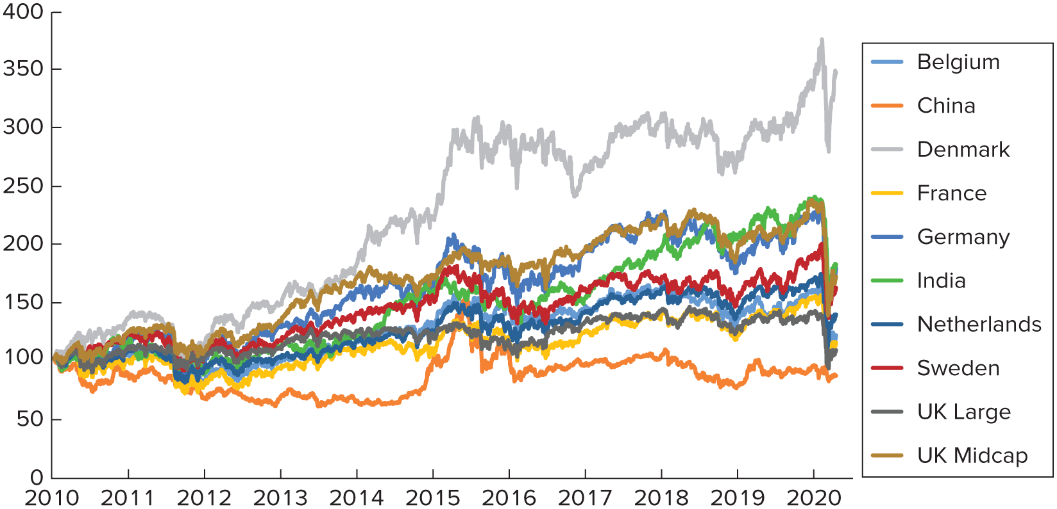
Stock Market Performance of Selected Countries
The Historical Record

Slide 14
The Historical Record
Table 11.1 Year-by-year stock market index levels for different countries, 2010–2020
Date | Belgium | China | Denmark | France | Germany | India | Netherlands | Sweden | UK Large | UK Midcap
01/01/2010 | 100 | 100 | 100 | 100 | 100 | 100 | 100 | 100 | 100 | 100
03/01/2011 | 104.7866 | 85.68684 | 137.1855 | 99.09891 | 117.3281 | 117.7284 | 108.7594 | 123.6551 | 108.9982 | 124.1962
02/01/2012 | 84.18152 | 67.11394 | 118.2393 | 81.86051 | 101.9822 | 88.8525 | 95.12705 | 105.013 | 102.9448 | 108.5529
01/01/2013 | 98.57423 | 69.24113 | 147.364 | 92.4991 | 127.7798 | 112.1158 | 101.5277 | 116.0772 | 108.9588 | 132.9657
01/01/2014 | 116.4117 | 64.56784 | 182.8091 | 109.1359 | 160.3403 | 121.0461 | 116.6859 | 140.0569 | 124.6857 | 171.221
01/01/2015 | 130.8024 | 98.7043 | 221.1055 | 108.5465 | 164.5936 | 157.5027 | 124.3858 | 153.8845 | 121.3049 | 172.8337
01/01/2016 | 147.3272 | 107.9961 | 301.2177 | 117.8016 | 180.3296 | 149.7921 | 130.5811 | 152.0216 | 115.3235 | 187.2787
02/01/2017 | 144.537 | 94.70578 | 267.2963 | 124.0338 | 194.6868 | 152.2802 | 140.9585 | 160.4285 | 131.9599 | 194.2353
01/01/2018 | 158.3791 | 100.9164 | 304.2027 | 134.9623 | 216.8324 | 193.605 | 156.4486 | 165.6937 | 142.0273 | 222.698
01/01/2019 | 129.1449 | 76.09992 | 264.8014 | 120.1802 | 177.2402 | 207.5864 | 138.2351 | 148.0204 | 124.2985 | 188.0548
01/01/2020 | 157.5011 | 93.07265 | 337.34 | 151.8689 | 222.3947 | 236.51 | 166.3538 | 186.1735 | 139.3425 | 235.1314
27/04/2020 | 120.8957 | 85.91305 | 347.2096 | 114.4533 | 178.9361 | 181.7545 | 138.7302 | 161.7608 | 108.0163 | 171.4076
Source: Yahoo! Finance. © 2020 Yahoo! All rights reserved.

Slide 15
The Historical Record
Table 11.2 Annual returns for different countries, 2010–2020
Date | Belgium | China | Denmark | France | Germany | India | Netherlands | Sweden | UK Large | UK Midcap
2010 | 4.79% | –4.31% | 37.19% | –0.90% | 17.33% | 17.73% | 8.76% | 23.66% | 9.00% | 24.20%
2011 | –19.66% | –21.68% | –13.81% | –17.40% | –13.08% | –24.53% | –12.53% | –15.08% | –5.55% | –12.60%
2012 | 17.10% | 3.17% | 24.63% | 13.00% | 25.30% | 26.18% | 6.73% | 10.54% | 5.84% | 22.49%
2013 | 18.10% | -6.75% | 24.05% | 17.99% | 25.48% | 7.97% | 14.93% | 20.66% | 14.43% | 28.77%
2014 | 12.36% | 52.87% | 20.95% | –0.54% | 2.65% | 30.12% | 6.60% | 9.87% | –2.71% | 0.94%
2015 | 12.63% | 9.41% | 36.23% | 8.53% | 9.56% | –4.90% | 4.98% | –1.21% | –4.93% | 8.36%
2016 | –1.89% | –12.31% | –11.26% | 5.29% | 7.96% | 1.66% | 7.95% | 5.53% | 14.43% | 3.71%
2017 | 9.58% | 6.56% | 13.81% | 8.81% | 11.37% | 27.14% | 10.99% | 3.28% | 7.63% | 14.65%
2018 | –8.46% | –24.59% | –12.95% | –10.95% | –18.26% | 7.22% | –11.64% | –10.67% | –12.48% | –15.56%
2019 | 21.96% | 22.30% | 27.39% | 26.37% | 25.48% | 13.93% | 20.34% | 25.78% | 12.10% | 25.03%
Jan–Apr 2020 | –23.24% | –7.69% | 2.93% | –24.64% | –19.54% | –23.15% | –16.61% | –13.11% | –22.48% | –27.10%
Source: Yahoo! Finance. © 2013 Yahoo! All rights reserved. Note: returns are for period January–

Slide 16
Average Returns: The First Lesson

Slide 17
Average Returns: The First Lesson

Slide 18
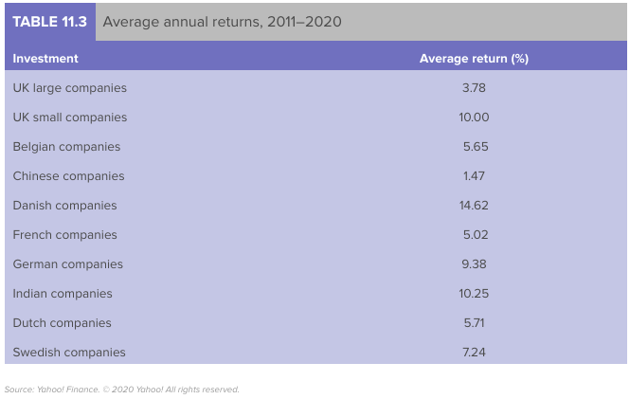

Slide 19
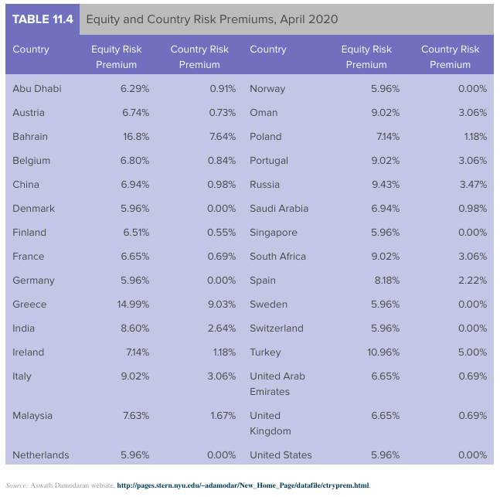

Slide 20
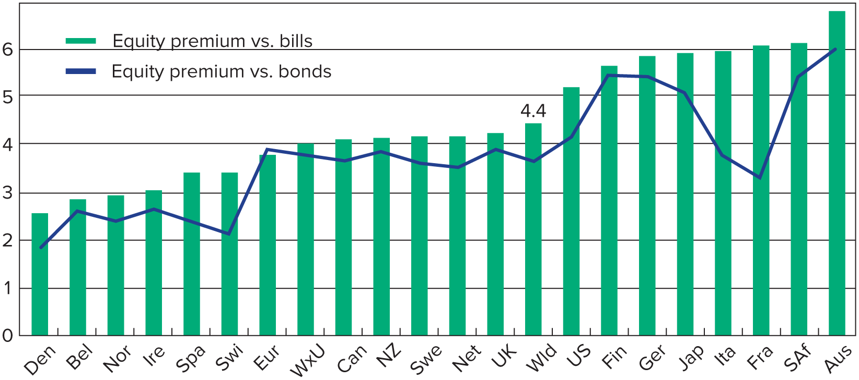
Equity Risk Premiums, 1900 - 2010

Slide 21
Average Returns: The First Lesson
Risk Premium is the return on a risky asset less the return on the risk-free security
The higher the risk premium, the more risky the investment
Government Treasury bills are used as the risk-free asset

Slide 22
The Variability of Returns: The Second Lesson

Slide 23
Variance and Standard Deviation
Variance
The average squared difference between the actual return and the average return.
Standard Deviation
The positive square root of the variance.

Slide 24
Suppose a particular investment had returns of 10 per cent, 12 per cent, 3 per cent and -9 per cent over the last 4 years.
The average return =
(0.10 + 0.12 + 0.03 - 0.09)/4 = 4%
What is the Standard Deviation of Returns?

Slide 25
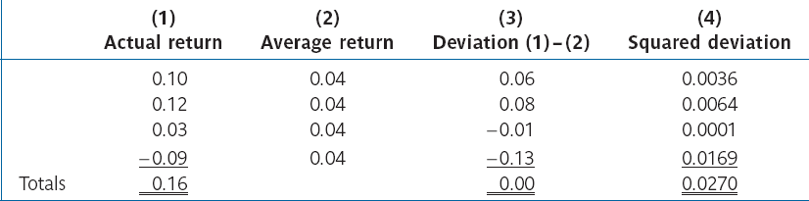
The Variability of Returns: The Second Lessons
Var(R) = σ² = 0.027/(4 - 1) = 0.009
SD(R) = σ = √0.009 = 0.09487

Slide 26
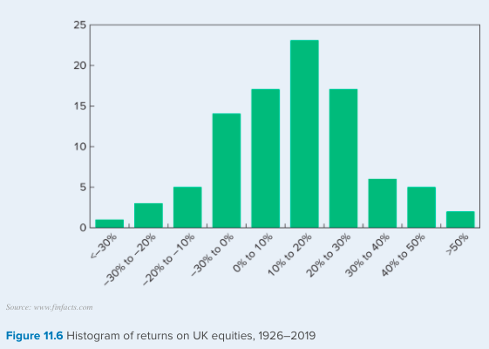

Slide 27
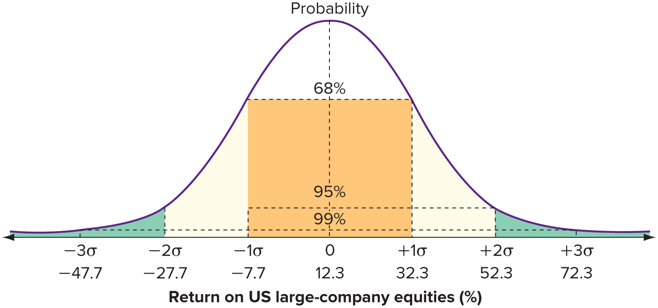
Stock Return Distributions: The Normal Distribution

Slide 28
More about Average Returns

Slide 29
Arithmetic Average Return
The return earned in an average year over a multi-year period.
Geometric Average Return
The average compound return earned per year over a multi-year period.
Tells you what you earn in a typical year.
Tells you what you actually earned per year on average, compounded annually.

Slide 30
More about Average Returns
If we have T years of returns, the geometric average return over these T years is calculated using:
Geometric average return
= [(1 + R₁) x (1 + R₂) x … x (1 + R_{T})] ^{1/T} – 1

Slide 31
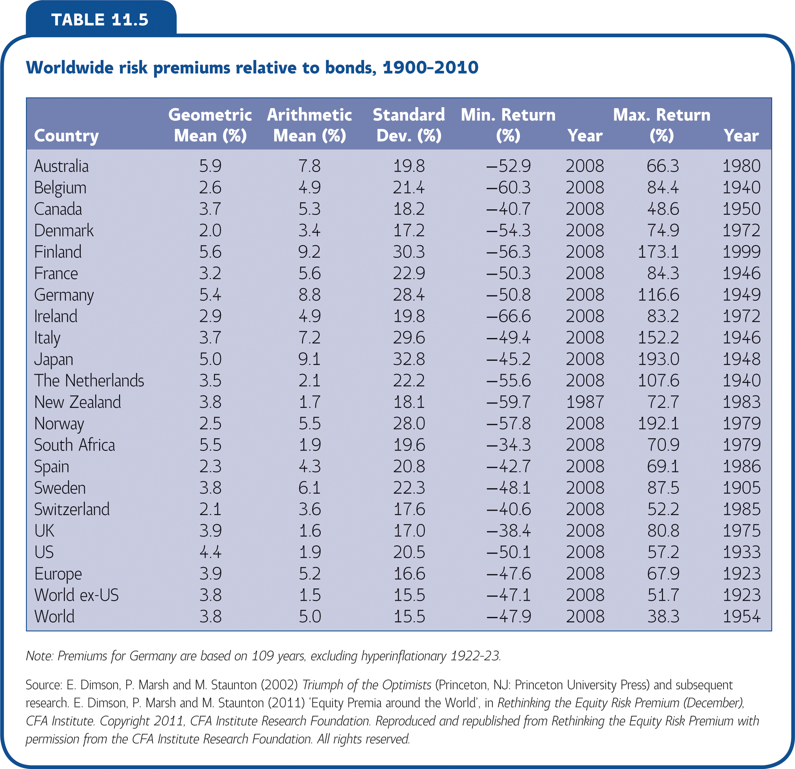
More about Average Returns

Slide 32
Capital Market Efficiency

Slide 33
Efficient Capital Market
A market in which security prices reflect available information
Efficient Markets Hypothesis
The hypothesis that actual capital markets are efficient

Slide 34
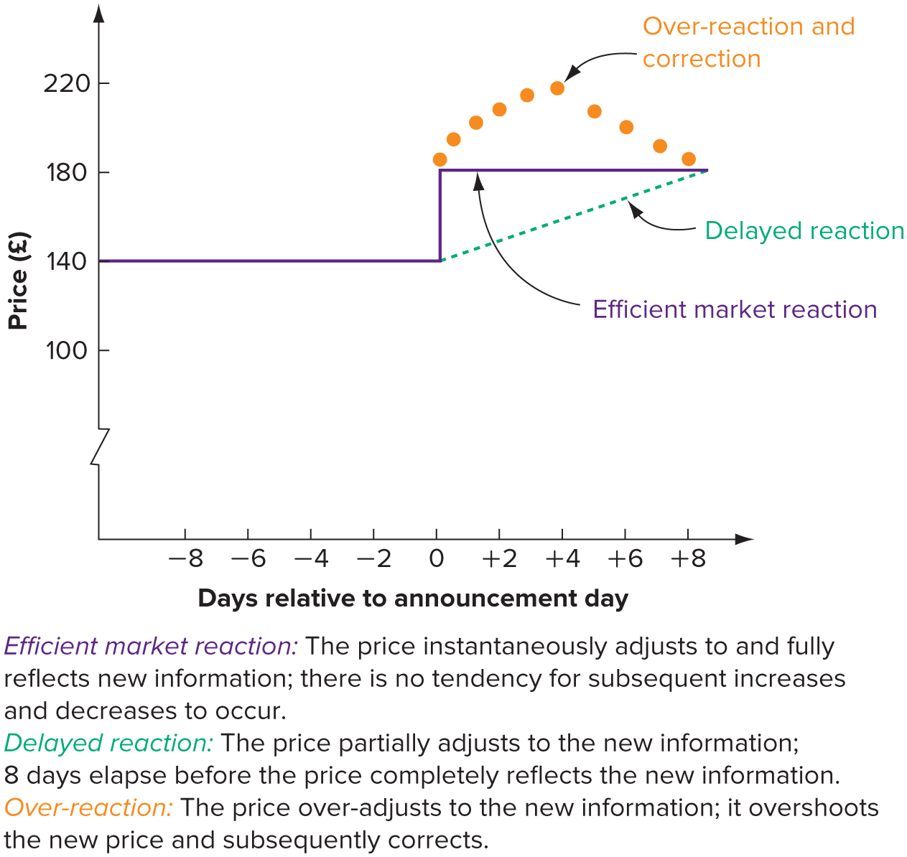
Price Behaviour in an Efficient Market

Slide 35
Different Forms of Market Efficiency
Weak
Semi-Strong
Strong

Slide 36
Concept Quiz
How much do you understand?
Quiz
What are the two parts of total return? What is the difference between a cash return and a percentage return? Which type is more convenient and why?
What is meant by excess return and risk premium?
What were the first and second lessons from capital market history?

Slide 37
Concept Quiz

Slide 38
What are the two parts of total return? What is the difference between a cash return and a percentage return? Which type is more convenient and why?
What is meant by excess return and risk premium?
What are the first and second lessons from capital market history?

